Slide 1


Power BI Audit Log Analysis; Usage Metrics Across the Entire Emerge Tenant
Lightweight Technical Design
Author: Manish Singh

Slide 2

Document Control
Definitions
Term | Definition
usage metrics | This is users activity recorded against PowerBI report dataset etc
Location
Location: | <Location of the document>
Revision history
Version | Date | Name | Role | Signature
1.0 | 28/08/2023 | Manish | BI developer
Document Sign Off
Version | Date Issued | Author | Authoriser | Description
0.1
0.2
0.3

Slide 3
Business Problem Assessment
This section is designed to capture key information that will inform next steps, and or any proposed solution
Request Details
Complexity and Impact Assessment
Requested By | Chris Negus
Entity, Team or Service | BI Team
Urgency & Impact | Medium | Low
Technical complexity | Medium – Medium Technical complexity
Kaimahi Impact | Small –No change impact to kaimahi
Is this a project
Technical Considerations
Data | PowerBI activity log data contains details for every interaction that users in the Emerge tenant have with the Power BI service.
Security | Power BI audit logs do not contain any PII(Personal Identifiable Information)data. The solution needs a security group in Azure active directory,
Third-Party Requirements | We will extract data from Power BI services
Integration | Power BI usage data will be integrated to our BI platform to get slice and dice analysis
Resource Requirements
Infrastructure | Data Factory, Synapse,data container
Applications | Power BI report
Services Desk
Data & Reporting | EDW
Architecture | Kimball methodology
Technology Involved
Record Base |  | Waharoa |  | Business Central |  | Web Expenses |  | Intilli HR |  | Emp Live |  | Azure |  | M365 |  | Data Wahouse |  | Power BI Datasets |  | Reporting |  | Other

Slide 4
Business Problem Overview
This section provides a general overview of the problem space. It should describe what the problem is, what is needed, who is asking and how urgent is it, along with any other information or considerations
Emerge PowerBI Platform has around 90 reports accessed by 200 users. PowerBI Platform has legacy reports as well as reports developed from the New BI platform .
As a BI team, we want to analyse the usage of reports delivered by the BI Platform across all Emerge tenants and teams.
Power BI Activity logs only contain Up to 30 days of history which limits our insight capabilities to analyse usage or trend of reports.
Integrating Power BI activity event entities into an Azure Blob Storage Account(dataLanding,ODS) followed by EDW SQL database.
The stored data can then be used to build a custom usage report on top of the EDW data and can be integrated with Other EDW entities like employees and team to get better insight.
Request Details | Response
Requested By | Chris Negus
Entity, Team or Service
Urgency & Impact | Medium | Low

Slide 5
TAB Guidance
This section captures any TAB or other input into the solution development
Section | Input Capture | Suggested by
Options for solution | Capture Activity log by calling PowerBI Rest API
Technology Stack | Azure data factory ,Synapse
Data | Power BI activity data ,Activity type
Security | New security group which can integrate Azure data factory to Power BI
Consultation
Support considerations
Licensing and Costs

Slide 6
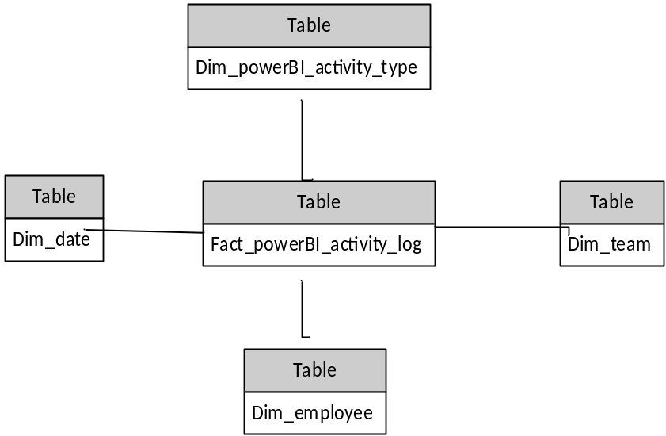
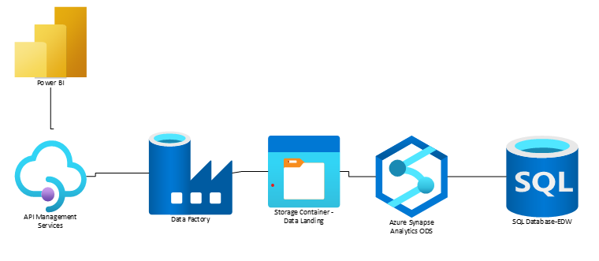
Data Model
This section provides a high-level overview of the proposed design

Slide 7
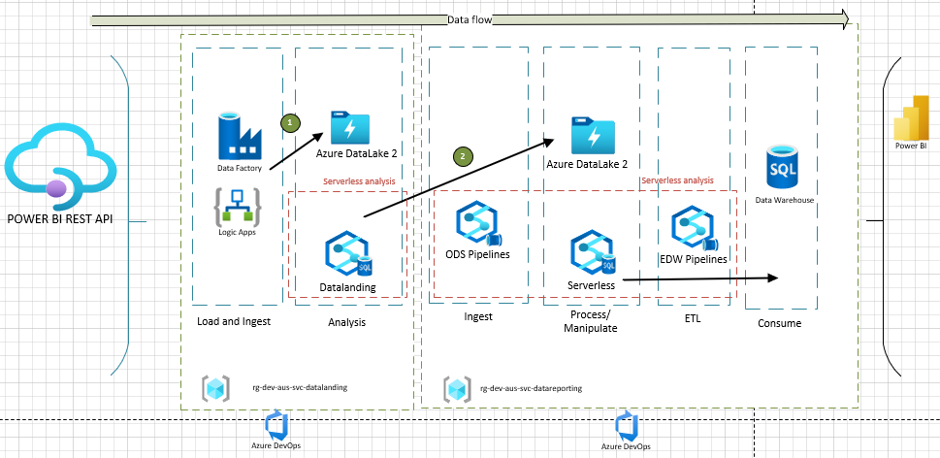
Proposed Solution
This section provides a high-level overview of the proposed design
Power BI dataset is 12th source to BI Platform
ADF will extract everyday data to the landing area.
Data will be extracted from the Landing area to ODS
ETL pipeline will extract and load incremental data to EDW.

Slide 8
Perspectives
This section is a list of possible perspectives that your solution should consider. Use the same diagram as created for your overview or a more details one. Provide a narrative that describes the solution from the chosen perspective.
Perspectives
Data Model | Kimball methodology and dimensional modelling
System Components | ADF,POWER BI, Synapse, key vault, SQL server
User experience | Report can be shared with managers or team leaders
Security | Incremental load is designed to handle any load performance
Integration and APIs | PowerBI REST API will provide data in JSON format
Deployment Strategy | Azure devOps will be used ro deploy pipeline and database objects
Error Handling and Logging | Error handling and logging module is included as part of ETL design
Testing Plan | Unit testing and system testing done
Maintenance and Support | BI support
Risks and Mitigations | NA
Costs and Licenses | NA

